Slide 1
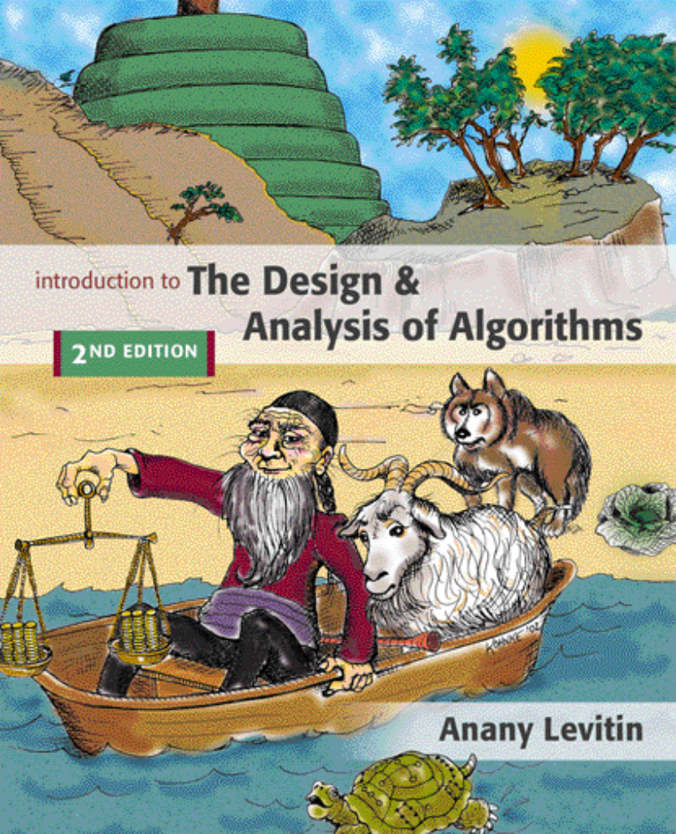

Chapter 2
Fundamentals of the Analysis of Algorithm Efficiency
Copyright © 2007 Pearson Addison-Wesley. All rights reserved.

Slide 2
Analysis of algorithms
Issues:
  correctness
  time efficiency
  space efficiency
  optimality
Approaches:
  theoretical analysis
  empirical analysis

Slide 3
Theoretical analysis of time efficiency
Time efficiency is analyzed by determining the number of repetitions of the basic operation as a function of input size
Basic operation: the operation that contributes most towards the running time of the algorithm
T(n) ≈ c_{op}C(n)
input size
running time
execution time
for basic operation
Number of times basic operation is executed

Slide 4
Input size and basic operation examples
Problem | Input size measure | Basic operation
Searching for key in a list of n items | Number of list’s items, i.e. n | Key comparison
Multiplication of two matrices | Matrix dimensions or total number of elements | Multiplication of two numbers
Checking primality of a given integer n | n’size = number of digits (in binary representation) | Division
Typical graph problem | #vertices and/or edges | Visiting a vertex or traversing an edge

Slide 5
Empirical analysis of time efficiency
Select a specific (typical) sample of inputs
Use physical unit of time (e.g., milliseconds)
or
Count actual number of basic operation’s executions
Analyze the empirical data

Slide 6
Best-case, average-case, worst-case
For some algorithms efficiency depends on form of input:
Worst case: C_{worst}(n) – maximum over inputs of size n
Best case: C_{best}(n) – minimum over inputs of size n
Average case: C_{avg}(n) – “average” over inputs of size n
  Number of times the basic operation will be executed on typical input
  NOT the average of worst and best case
  Expected number of basic operations considered as a random variable under some assumption about the probability distribution of all possible inputs

Slide 7
Activity
For each of the following algorithms, indicate (i) a natural size metric for its inputs, (ii) its basic operation, and (iii) whether the basic operation count can be different for inputs of the same size:
computing the sum of n numbers
b. computing n!
c. finding the largest element in a list of n number
d. Euclid’s algorithm
e. sieve of Eratosthenes
f. pen-and-pencil algorithm for multiplying two n-digit decimal integers

Slide 8
a. Glove selection There are 22 gloves in a drawer: 5 pairs of red gloves, 4 pairs of yellow, and 2 pairs of green. You select the gloves in the dark and can check them only after a selection has been made.What is the smallest number of gloves you need to select to have at least one matching pair in the best case? In the worst case?
b. Missing socks Imagine that after washing 5 distinct pairs of socks, you discover that two socks are missing. Of course, you would like to have the largest number of complete pairs remaining. Thus, you are left with 4 complete pairs in the best-case scenario and with 3 complete pairs in the worst case. Assuming that the probability of disappearance for each of the 10 socks is the same, find the probability of the best-case scenario;the probability of the worst-case scenario; the number of pairs you should expect in the average case.

Slide 9
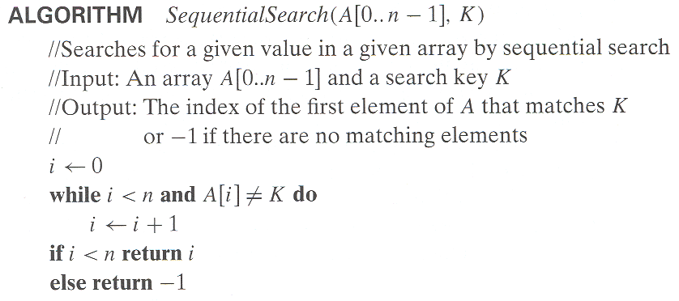
Example: Sequential search
Worst case
Best case
Average case

Slide 10
Time efficiency of nonrecursive algorithms
General Plan for Analysis
Decide on parameter n indicating input size
Identify algorithm’s basic operation
Determine worst, average, and best cases for input of size n
Set up a sum for the number of times the basic operation is executed
Simplify the sum using standard formulas and rules (see Appendix A)

Slide 11
Useful summation formulas and rules
Σ_{l≤i≤u}1 = 1+1+…+1 = u - l + 1
In particular, Σ_{l≤i≤u}1 = n - 1 + 1 = n ∈ Θ(n)
Σ_{1≤i≤n} i = 1+2+…+n = n(n+1)/2 ≈ n²/2 ∈ Θ(n²)
Σ_{1≤i≤n} i² = 1²+2²+…+n² = n(n+1)(2n+1)/6 ≈ n³/3 ∈ Θ(n³)
Σ_{0≤i≤n} a^{i} = 1 + a +…+ a^{n} = (a^{n+1} - 1)/(a - 1) for any a ≠ 1
In particular, Σ_{0≤i≤n} 2^{i} = 2⁰ + 2¹ +…+ 2^{n} = 2^{n+1} - 1 ∈ Θ(2^{n} )
Σ(a_{i} ± b_{i} ) = Σa_{i} ± Σb_{i} Σca_{i} = cΣa_{i} Σ_{l≤i≤u}a_{i} = Σ_{l≤i≤m}a_{i} + Σ_{m+1≤i≤u}a_{i}

Slide 12
Exercise 1: What does this algorithm do?
ALGORITHM Mystery(A[0..n − 1])
//
//Input: An array A[0..n − 1]
//Output:
//
for i ←0 to n − 2 do
for j ←i + 1 to n − 1 do
if A[i]= A[j ] return false
return true

Slide 13
Exercise 1: What does this algorithm do?
ALGORITHM UniqueElements(A[0..n − 1])
//Determines whether all the elements in a given array are distinct
//Input: An array A[0..n − 1]
//Output: Returns “true” if all the elements in A are distinct
// and “false” otherwise
for i ←0 to n − 2 do
for j ←i + 1 to n − 1 do
if A[i]= A[j ] return false
return true

Slide 14
Exercise 1: Analysis of UniqueElements Algorithm
Decide on parameter n indicating input size
n : the number of elements in the list
2. Identify algorithm’s basic operation
Comparison ( if A[i] = A[j] ) is the basic operation
3. Check whether the performance of algorithm depends on size of input and nature of input.
Best: First and second elements are same
Worst: i) No elements are equal
ii) Only last two elements are equal
Average: ???
4. Set up a sum for the number of times the basic operation is executed
5. Simplify the sum using standard formulas and rules

Slide 15
Exercise 2: Study the given algorithm
ALGORITHM Mystery(n)
//Input: A nonnegative integer n
S ←0
for i ←1 to n do
S ←S + i ∗ i
return S
Answer the following questions
a. What does this algorithm compute?
b. What is its basic operation?
c. How many times is the basic operation executed?
d. What is the efficiency class of this algorithm?
e. Suggest an improvement, or a better algorithm altogether, and indicate its
efficiency class. If you cannot do it, try to prove that, in fact, it cannot be
done.

Slide 16
Exercise 2: Study the given algorithm
ALGORITHM Mystery(n)
//Input: A nonnegative integer n
S ←0
for i ←1 to n do
S ←S + i ∗ i
return S
Answer the following questions
a. What does this algorithm compute? Computes the series 12 + 22 + .... + n2
b. What is its basic operation? Multiplication ( i * i)
c. How many times is the basic operation executed? n times
d. What is the efficiency class of this algorithm? O ( n)
e. Suggest an improvement, or a better algorithm altogether, and indicate its
efficiency class. If you cannot do it, try to prove that, in fact, it cannot be
done. S = n ( n + 1) (2n + 1) / 6, multiplication is done only three times

Slide 17
Exercise 3: Study the given algorithm
ALGORITHM Secret(A[0..n − 1])
//Input: An array A[0..n − 1] of n real numbers
minval←A[0]; maxval←A[0]
for i ←1 to n − 1 do
if A[i]< minval
minval←A[i]
if A[i]> maxval
maxval←A[i]
return maxval − minval
Answer the following questions
a. What does this algorithm compute?
b. What is its basic operation?
c. How many times is the basic operation executed?
d. What is the efficiency class of this algorithm?
e. Suggest an improvement, or a better algorithm altogether, and indicate its
efficiency class. If you cannot do it, try to prove that, in fact, it cannot be
done.

Slide 18
Exercise 4: Study the given algorithm
ALGORITHM Enigma(A[0..n − 1, 0..n − 1])
//Input: A matrix A[0..n − 1, 0..n − 1] of real numbers
for i ←0 to n − 2 do
for j ←i + 1 to n − 1 do
if A[i, j ] = A[j, i]
return false
return true
Answer the following questions
a. What does this algorithm compute?
b. What is its basic operation?
c. How many times is the basic operation executed?
d. What is the efficiency class of this algorithm?
e. Suggest an improvement, or a better algorithm altogether, and indicate its
efficiency class. If you cannot do it, try to prove that, in fact, it cannot be
done.

Slide 19
Thank you
Solutions to Exercises 3 & 4 in
the next slides

Slide 20
Exercise 3: Study the given algorithm
ALGORITHM Secret(A[0..n − 1])
//Input: An array A[0..n − 1] of n real numbers
minval←A[0]; maxval←A[0]
for i ←1 to n − 1 do
if A[i]< minval
minval←A[i]
if A[i]> maxval
maxval←A[i]
return maxval − minval
Answer the following questions
a. What does this algorithm compute? Largest and the smallest elements in the list.
b. What is its basic operation? Comparison
c. How many times is the basic operation executed? 2n times
d. What is the efficiency class of this algorithm? O ( n)
e. Suggest an improvement, or a better algorithm altogether, and indicate its efficiency class. If you cannot do it, try to prove that, in fact, it cannot be done.
Use else if. However, the efficiency class remains same.

Slide 21
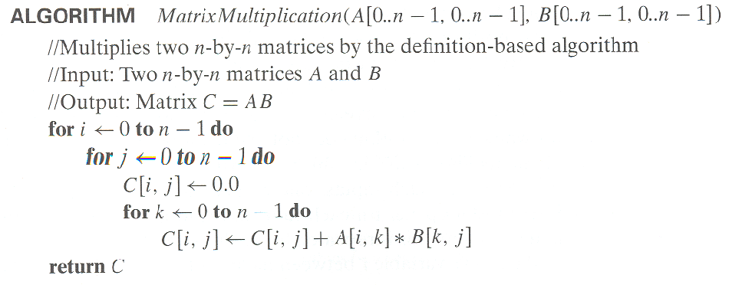
Example 3: Matrix multiplication

Slide 22
Exercise 4: Study the given algorithm
ALGORITHM Enigma(A[0..n − 1, 0..n − 1])
//Input: A matrix A[0..n − 1, 0..n − 1] of real numbers
for i ←0 to n − 2 do
for j ←i + 1 to n − 1 do
if A[i, j ] = A[j, i]
return false
return true
Answer the following questions
a. What does this algorithm compute?
b. What is its basic operation?
c. How many times is the basic operation executed?
d. What is the efficiency class of this algorithm?
e. Suggest an improvement, or a better algorithm altogether, and indicate its
efficiency class. If you cannot do it, try to prove that, in fact, it cannot be
done.

Slide 23
Plan for Analysis of Recursive Algorithms
Decide on a parameter indicating an input’s size.
Identify the algorithm’s basic operation.
Check whether the number of times the basic op. is executed may vary on different inputs of the same size. (If it may, the worst, average, and best cases must be investigated separately.)
Set up a recurrence relation with an appropriate initial condition expressing the number of times the basic op. is executed.
Solve the recurrence (or, at the very least, establish its solution’s order of growth) by backward substitutions or another method.

Slide 24
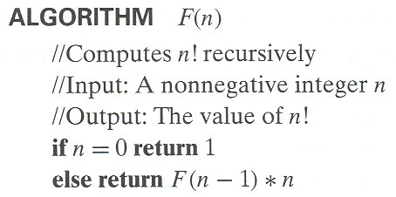
Example 1: Recursive evaluation of n!
Definition: n ! = 1 ∗ 2 ∗ … ∗(n-1) ∗ n for n ≥ 1 and 0! = 1
Recursive definition of n!: F(n) = F(n-1) ∗ n for n ≥ 1 and
F(0) = 1
Size:
Basic operation:
Recurrence relation:
Notes:
Note the difference between the two recurrences. Students often confuse these!
F(n) = F(n-1) n
F(0) = 1
for the values of n!
------------
M(n) =M(n-1) + 1
M(0) = 0
for the number of multiplications made by this algorithm

Slide 25
Solving the recurrence for M(n)
M(n) = M(n-1) + 1, M(0) = 0

Slide 26
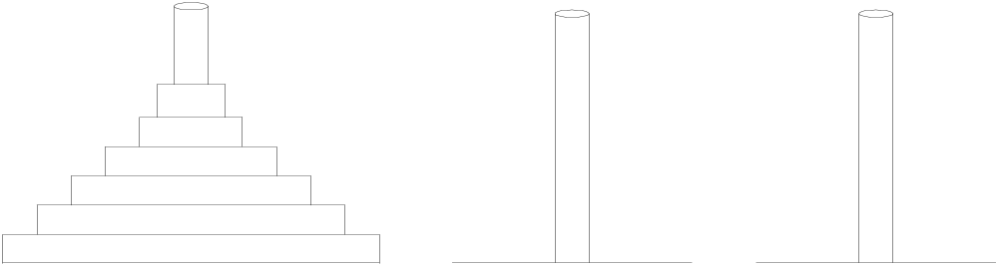
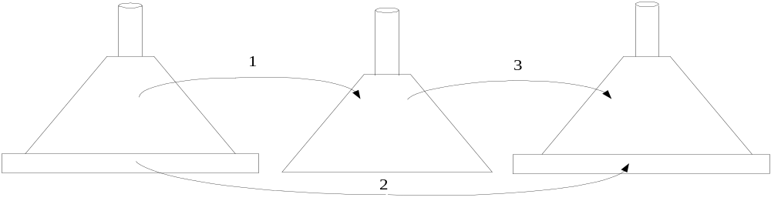
Example 2: The Tower of Hanoi Puzzle
Recurrence for number of moves:

Slide 27
Solving recurrence for number of moves
M(n) = 2M(n-1) + 1, M(1) = 1

Slide 28
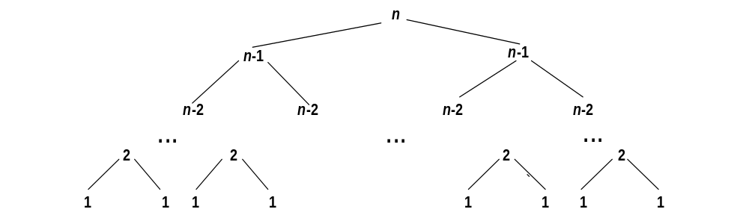
Tree of calls for the Tower of Hanoi Puzzle

Slide 29
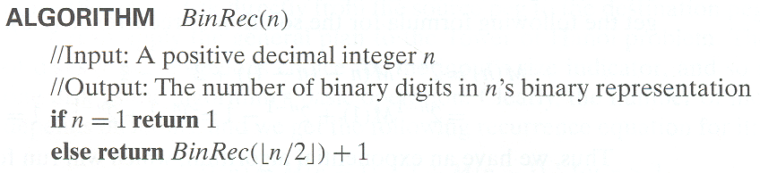
Example 3: Counting #bits

Slide 30
Fibonacci numbers
The Fibonacci numbers:
  0, 1, 1, 2, 3, 5, 8, 13, 21, …
The Fibonacci recurrence:
  F(n) = F(n-1) + F(n-2)
  F(0) = 0
  F(1) = 1
General 2nd order linear homogeneous recurrence with
constant coefficients:
  aX(n) + bX(n-1) + cX(n-2) = 0

Slide 31
Solving aX(n) + bX(n-1) + cX(n-2) = 0
Set up the characteristic equation (quadratic)
ar² + br + c = 0
Solve to obtain roots r₁ and r₂
General solution to the recurrence
  if r₁ and r₂ are two distinct real roots: X(n) = αr₁^{n} + βr₂^{n}
  if r₁ = r₂ = r are two equal real roots: X(n) = αr^{n} + βnr ^{n}
Particular solution can be found by using initial conditions

Slide 32
Application to the Fibonacci numbers
F(n) = F(n-1) + F(n-2) or F(n) - F(n-1) - F(n-2) = 0
Characteristic equation:
Roots of the characteristic equation:
General solution to the recurrence:
Particular solution for F(0) =0, F(1)=1:

Slide 33
Computing Fibonacci numbers
Definition-based recursive algorithm
Nonrecursive definition-based algorithm
Explicit formula algorithm
Logarithmic algorithm based on formula:
n
F(n-1) F(n)
0 1
=
F(n) F(n+1)
1 1
for n≥1, assuming an efficient way of computing matrix powers.

